Slide 1

Machine Learning
Sundeep Gullapudi
June 12, 2017

Slide 2
Agenda
Introduction
Different perspectives about machine learning
Python Basics
Few Example Programs
Tools and Tweaks
Python and Anaconda Installation
Basics of Machine Learning
Different Types

Slide 3

Introduction
Any previous experience with python and machine learning ?
Expectations about the session
Perspective about machine learning

Slide 4
Basics of Python Programming

Slide 5
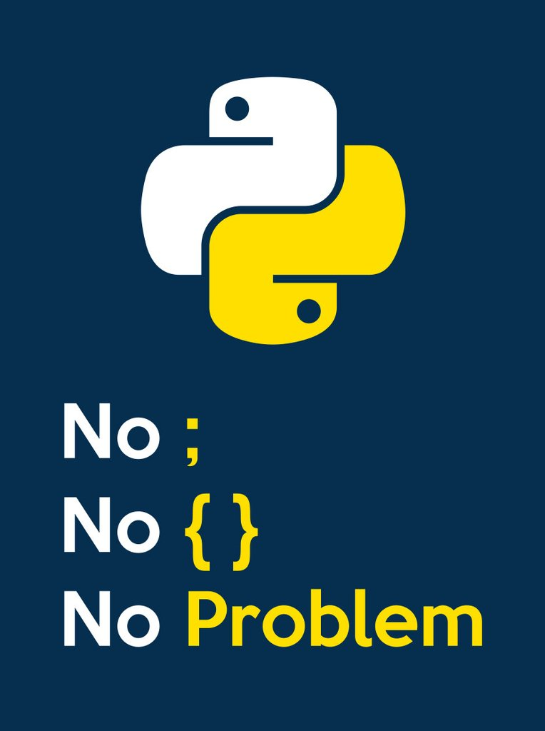
Python Basics
Basic Syntax
Identifiers (Variables)
Reserve Words
Lines and Indentation
Multi Line Statements
Comments
Input
print
Variables Types
Numbers
Strings
Lists
Tuples
Dictionaries

Slide 6
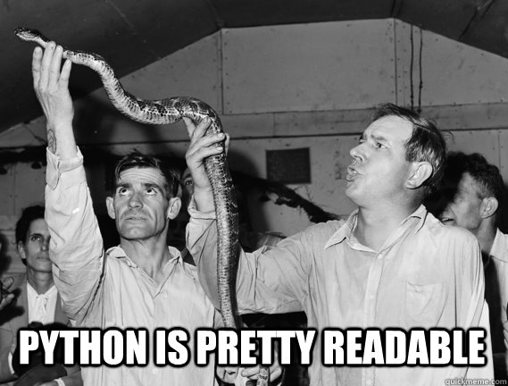
Python Basics
Basic Operators
Arithmetic Operators (+,-, /, *, **, //)
Comparison (Relational) Operators (> , < ..)
Assignment Operators (= , >= ..)
Logical Operators (AND, OR, NOT)
Bitwise Operators (&, | .. )
Membership Operators (in)
Identity Operators (is)
Decision Making
If..elif..else
Loops
While
for

Slide 7
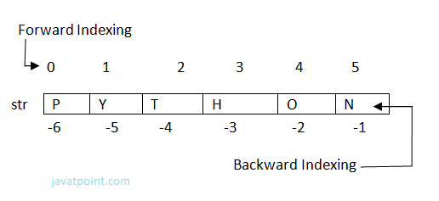
Python Basics
Numbers (Built in functions)
abs(x), round(x),ceil(x), floor(x), round(x)
exp(x), log(x), log10(x)
max(x1,x2,x3 ..), min(x1, x2, ..)
Strings
Operators : +, *, [], in, r/R, %(formatter)
Formatters: %c, %s, %d, %u, %f
example: print ("My name is %s and weight is %d kg!" % (‘Sundeep', 99))
Built-in Functions : find(), join(), len()

Slide 8
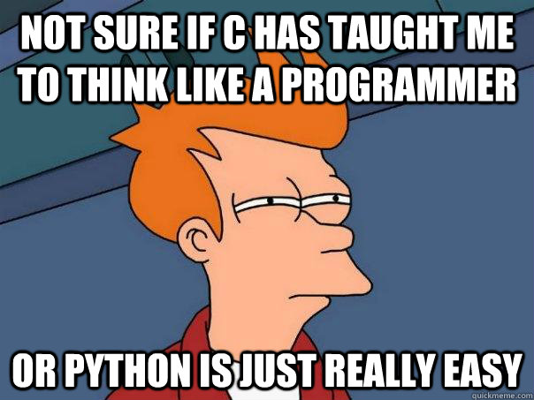
Python Basics
Lists
append(), count(), insert(index, obj), pop(), remove(), sort(), reverse()
Tuples
Dictionaries
dict.items(), dict.keys(), dict.values()

Slide 9
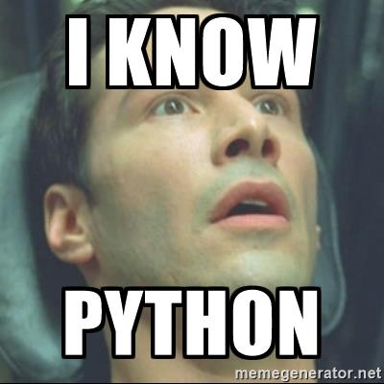
Python Basics
Functions
Definition and Calling
With Required Arguments
With Keyword Arguments
With Default Arguments
With Variable-length Arguments
Modules
Import
from..import
dir()

Slide 10
Python Basics
“Let’s Solve some programs”
Hands on

Slide 11



Tools and Tweaks
Python
Jupyter notebook
Anaconda – Basic Usage

Slide 12
Thank you.
Contact information:
Sundeep Gullapudi
Partner logo

